Slide 1
USAID Zambia Evidence For Health (E4H)
PRESENTATION ON MATERNAL and PERINATAL HEALTH INDICATORS - DHIS2 data FOR 2018-2021
Zambia Evidence for Health Project
March 2022

Slide 2

MATERNAL AND PERINATAL HEALTH
Photo credit: Gender Links

Slide 3
Overview of Data Trends 2018 - 2021
Data now covers all of 2021 – will look at cumulative trends since 2018
Categorize data into trending positively, negatively, and remaining consistent
Trends are VERY slight – DO NOT PANIC!
Discussion on MPDSR and DHIS2 data trends

Slide 4
Reviewing Data
Changes in trends – always look for any outliers
Understand data strengths and weaknesses
Things to keep in mind for additional data analysis
Look at areas for primary research to look into some trends

Slide 5
Maternal and Perinatal Health Dashboard
Negative Trend | No Change | Positive Trend
Folic acid and Iron Supplementation during ANC | First ANC Coverage | Maternal Post Natal Care Within 48 Hours after Delivery
High Risk Pregnancies at 1st ANC | First ANC Coverage in Frist Trimester | Neonatal Deaths
Maternal Mortality ratio per 100,000 births | Stillbirth Rate per 1000 live births | Perinatal Deaths
 | Delivery Outcomes per 1000 live births
 | Institutional Delivery Coverage
 | Cesarean Section Rates

Slide 6
POSITIVE TREND

Slide 7
Maternal postnatal care within 48 hours after delivery: 2018 – 2021 Yearly Targets vs Achieved
Notes:
While this indicator is trending positively, it is still far from national targets.

Slide 8
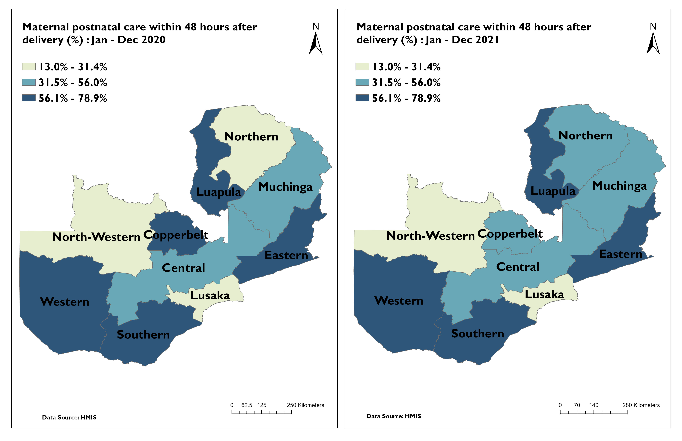
Maternal postnatal care within 48 hours after delivery (%) by Province
Notes:
Need to keep an eye on Copperbelt which dropped in 2021. Northern increased.

Slide 9
Number of Neonatal Deaths for Jan – Dec 2020 and 2021
Notes:
We can see a slight decrease in 2021, particularly in October and November

Slide 10
PDSR SLIDES

Slide 11
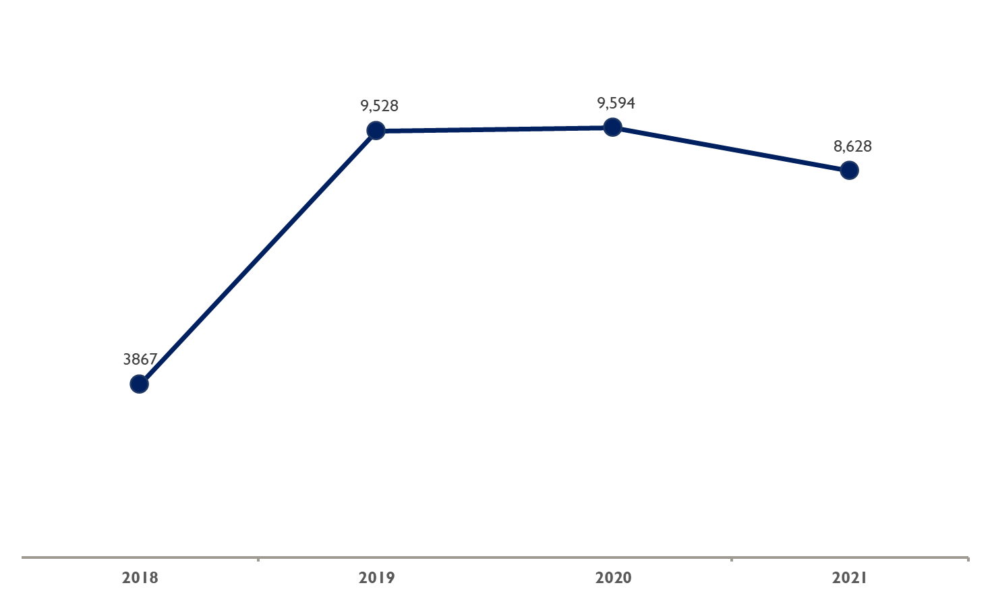
Total number of Perinatal Deaths: 2018-2021
After inclusion of MSB & FSB in 2019

Slide 12
Perinatal mortality rate per 1000 total births 2019-2021
Notes:
The target for neonatal mortality for 2021 was at 12 per 1000 live births, perinatal mortality which is a subset of neonatal mortality stands at 15.07 per 1000 total births. Denominator for perinatal mortality is live births plus still births

Slide 13
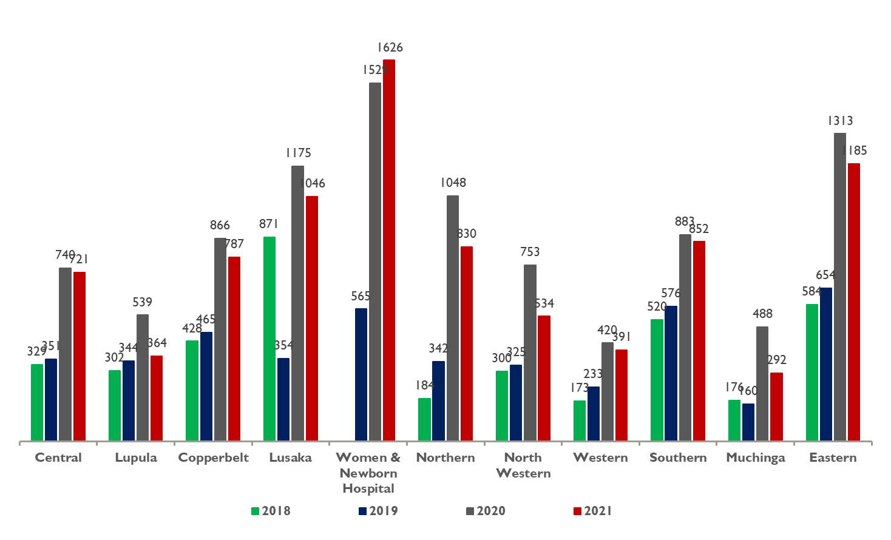
Number of Perinatal deaths by Province 2018-2021
Notes:
In looking at per province numbers, UTH provides the highest numbers of perinatal mortality.

Slide 14
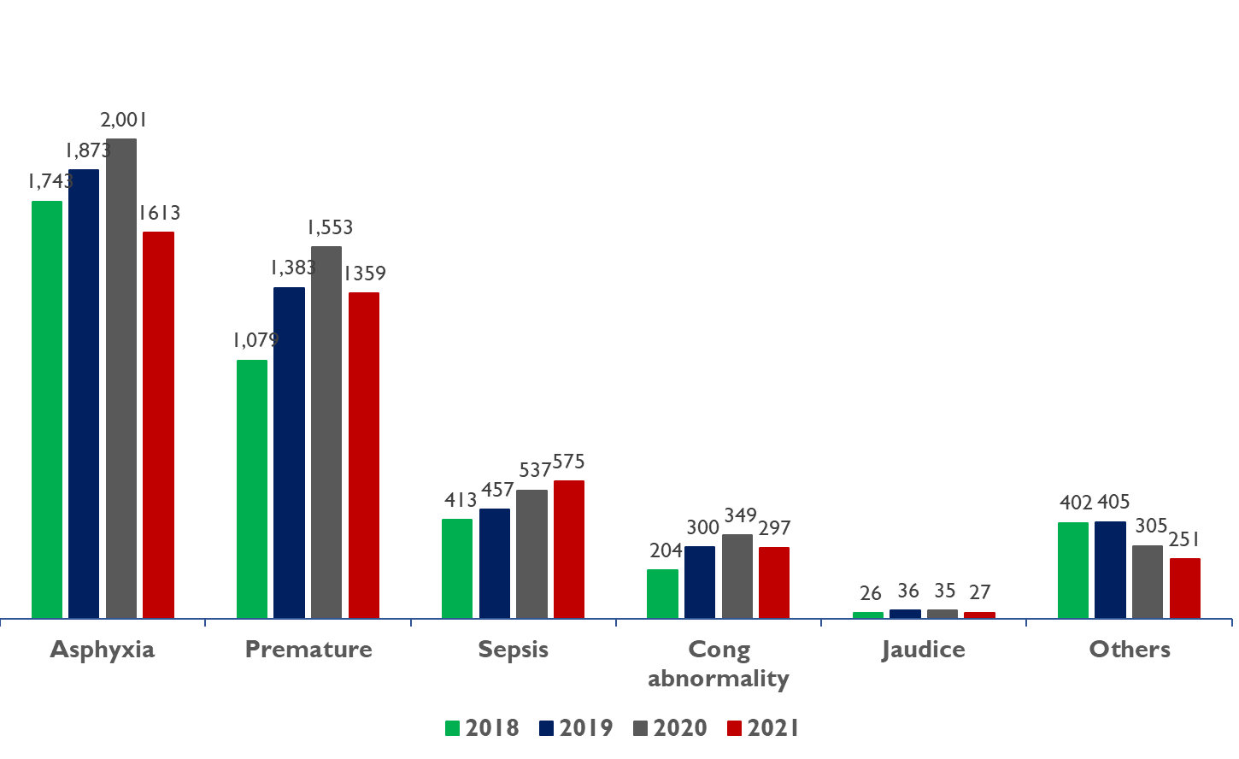
Causes of Perinatal deaths by Province 2018-2021

Slide 15
NEGATIVE TREND

Slide 16
Folic acid and Iron Supplementation during ANC by Quarter from 2018 to 2021
Notes:
There has been a steady decrease in both iron and folic acid supplements. There were some issues with stock availability in 2021 as can be seen from the data compared to 2020.

Slide 17
High-risk pregnancies at 1st ANC by Quarter from 2018 to 2021
Notes:
Overall slight increase in high risk pregnancies at first ANC since 2018 for each quarter.

Slide 18
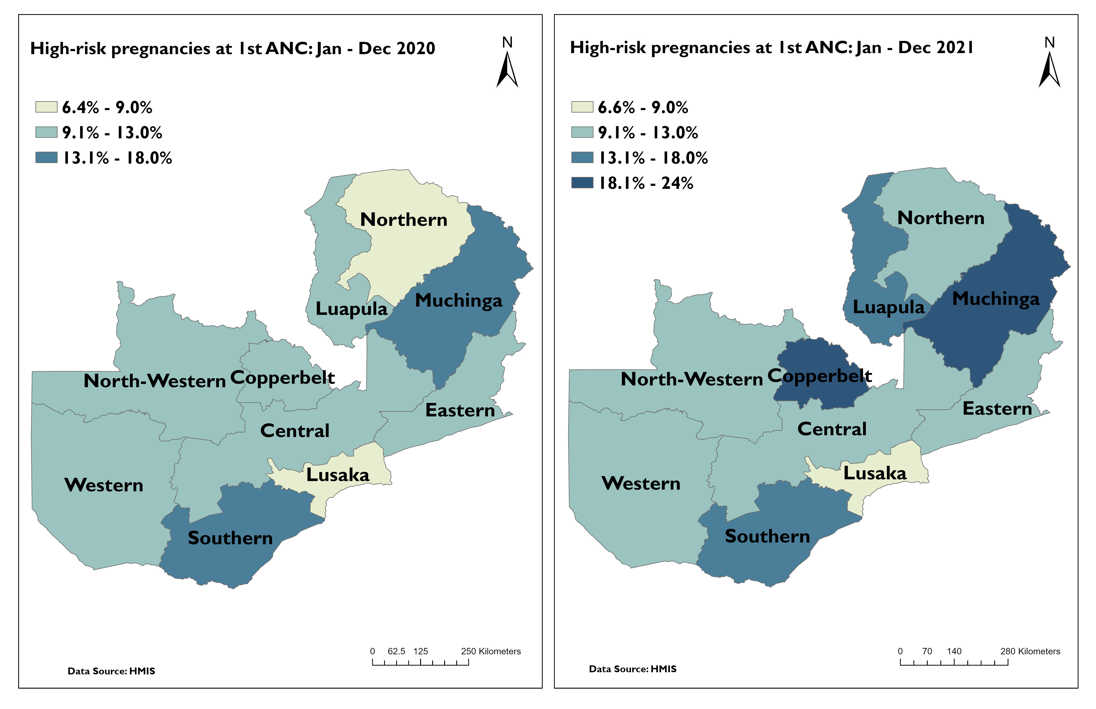
High-risk pregnancies at 1st ANC: Jan-Dec 2020 & 2021
Notes:
The numbers of high risk pregnancies increased in Copperbelt, Northern and Muchinga Provinces in 2021

Slide 19
MATERNAL MORTALITY

Slide 20
Maternal Mortality Datasets
Differences between DHS, MPDSR, and DHIS2 data
Notes:
DHS Data
252 maternal deaths per 100,000 live births
MPDSR Data
2021 129/100,000
DHIS2
2021 116/100,000

Slide 21
Maternal mortality ratio per 100 000 deliveries: 2018 – 2021 Yearly Targets vs Achieved DHIS2
Notes:
There was a trend toward a decline between 2018 and 2019 and then a slight increase began in the DHIS2 data in 2020 and more so in 2021.

Slide 22
Number of Maternal death by province for 2020 and 2021

Slide 23
Provincial distribution of the number of Maternal deaths
Province | 2021
Province | Jan | Feb | Mar | Apr | May | Jun | Jul | Aug | Sep | Oct | Nov | Dec | Total
Central | 8 | 4 | 6 | 4 | 3 | 3 | 6 | 5 | 5 | 5 | 6 | 4 | 59
Copperbelt | 13 | 11 | 12 | 5 | 9 | 11 | 9 | 8 | 7 | 4 | 6 | 6 | 101
Eastern |  | 1 | 6 | 6 | 3 | 3 | 5 | 6 | 6 | 2 | 13 | 9 | 60
Luapula | 1 | 2 | 1 | 3 | 1 | 4 | 1 |  | 2 | 2 | 3 | 3 | 23
Lusaka(without UTH Newborn) | 6 | 4 | 11 | 3 | 3 | 6 | 6 | 10 | 5 | 4 | 12 | 1 | 71
UTH Newborn | 8 | 10 | 18 | 12 |  |  | 14 | 13 | 10 |  |  | 7 | 92
Muchinga | 3 | 10 | 7 |  | 4 | 1 | 3 | 6 | 5 | 1 | 4 | 2 | 46
Northern | 3 | 4 | 5 | 7 | 9 | 7 | 5 | 7 | 8 | 8 | 8 | 3 | 74
Northwestern | 1 | 5 | 6 | 4 | 5 | 2 | 1 | 2 | 2 | 1 |  | 3 | 32
Southern |  | 10 | 6 | 3 | 3 | 8 | 3 | 7 | 3 | 6 | 3 | 9 | 61
Western | 6 | 2 |  | 3 | 5 | 6 | 4 | 2 | 5 | 1 | 1 | 2 | 37
Total |  |  |  |  |  |  |  |  |  |  |  |  | 656
Notes:
You can see Copperbelt and UTH show the highest numbers of maternal mortality in DHIS2

Slide 24
MDSR DATA

Slide 25
Trend of Maternal Deaths 2015-2021

Slide 26
Maternal Deaths by Provinces 2015-2021
Location | 2015 | 2016 | 2017 | 2018 | 2019 | 2020 | 2021
Central | 76 | 78 | 96 | 70 | 64 | 77 | 73
Copperbelt | 97 | 72 | 97 | 78 | 85 | 106 | 88
Eastern | 90 | 92 | 96 | 96 | 71 | 69 | 62
Luapula | 64 | 72 | 78 | 72 | 39 | 22 | 19
Lusaka | 171 | 162 | 163 | 159 | 164 | 209 | 180
Muchinga | 56 | 38 | 47 | 45 | 40 | 49 | 43
Northern | 91 | 94 | 79 | 78 | 80 | 63 | 71
North-Western | 41 | 40 | 40 | 48 | 50 | 55 | 38
Southern | 69 | 70 | 70 | 86 | 66 | 61 | 69
Western | 33 | 50 | 43 | 55 | 67 | 44 | 64
Zambia | 788 | 768 | 809 | 788 | 726 | 755 | 707
** indicates a large discrepancy from DHIS2 data
Notes:
Consistently, Copperbelt and Lusaka/UTH show the highest number of mortality

Slide 27
Maternal Mortality Ratio By Province (2021 MPDSR Data)
Province | MD (DHIS 2) | MDs | Live Births | MMR
Central | 59 | 73 | 56,097 | 130/100,000
Copperbelt | 101 | 88 | 65,509 | 134/100,000
Eastern | 60 | 62 | 82,871 | 75/100,000
Luapula | 23 | 19 | 56,043 | 34/100,000
Lusaka | 163 | 180 | 75,864 | 237/100,000
Muchinga | 46 | 43 | 33,752 | 127/100,000
Northern | 74 | 71 | 53,752 | 135/100,000
Northwestern | 32 | 38 | 29,621 | 128/100,000
Southern | 61 | 69 | 62,493 | 110/100,000
Western | 37 | 64 | 34,045 | 188/100,000
Zambia | 656 | 707 | 549,027 | 129/100,000

Slide 28
% Causes of Maternal deaths

Slide 29
CONSISTENT

Slide 30
1st ANC Coverage by month by Quarter from 2018 to 2021

Slide 31
1st ANC visits done in the 1st trimester <20years by Quarter from 2018 to 2021

Slide 32
1st ANC (1st Trimester) coverage: 2018 – 2021 Yearly Targets vs Achieved

Slide 33
Stillbirth rate per 1000 live birth in health facility by quarter from 2018 to 2021

Slide 34
Delivery outcomes per 1000 live births: 2018-2021

Slide 35
Institutional Delivery coverage (%) by quarter from 2018 to 2021
Notes:
2021 overall saw fairly consistent numbers with previous years.

Slide 36
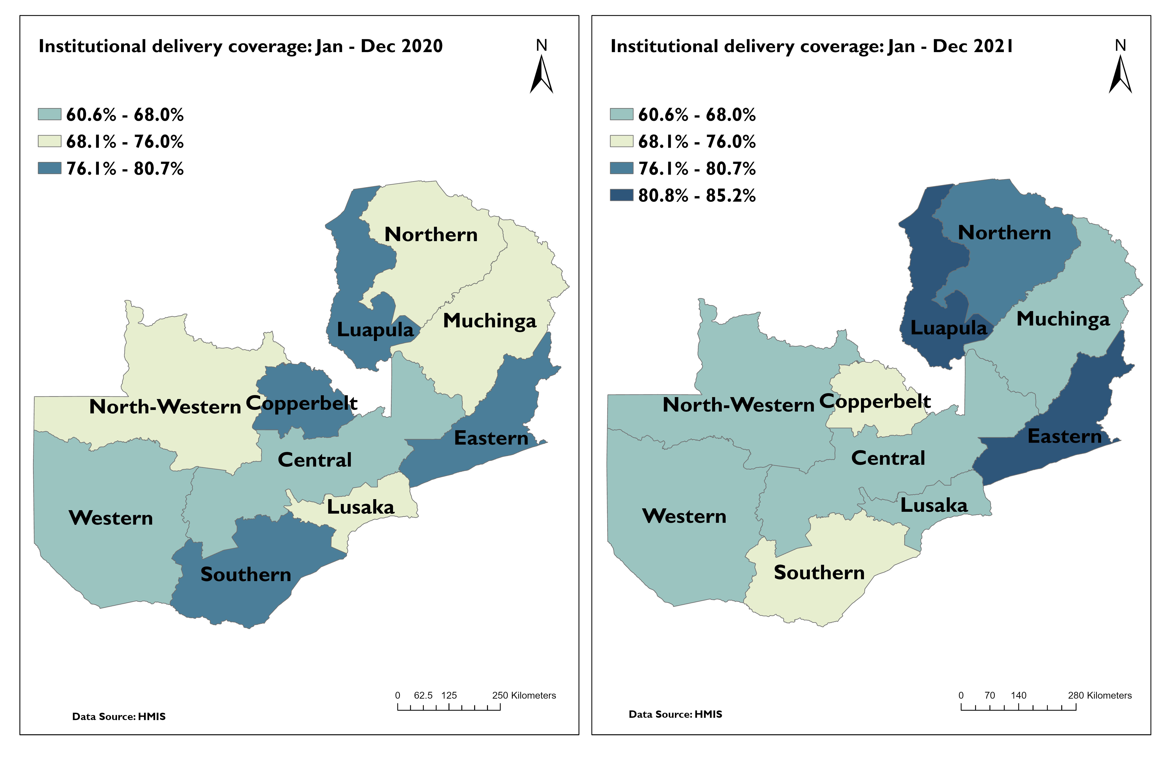
Institutional delivery coverage: Jan – Dec 2020 & 2021
Notes:
Saw increases in Eastern, Northern and Luapula with decreases in North Western, Copperbelt, Lusaka, Southern, and Muchinga

Slide 37
Caesarean section rates (%) by quarter from 2018 to 2021

Slide 38
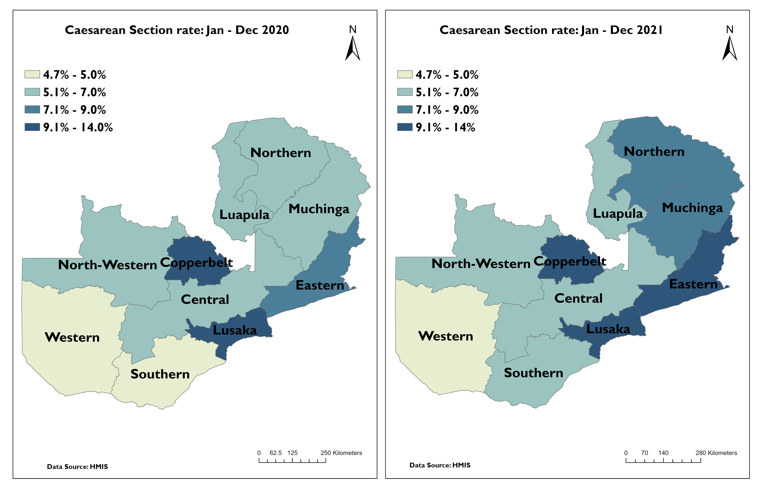
Caesarean section rates: Jan – Dec 2020 & 2021
Notes:
Northern, Muchinga and Southern all saw an increase in 2021

Slide 39
Areas to Follow Up

